Slide 1
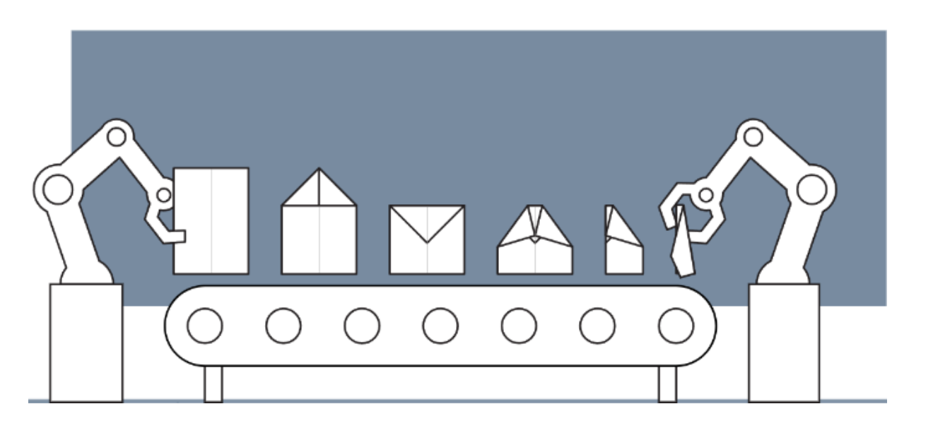
Design of Cyber-Physical Systems in Manufacturing
Development of a Digital Twin for a Robotic Paper Plane Production Line
Kaiserslautern, 16.12.2024
Lukas | Hakim

Slide 2
Agenda
Get params of the folding step
Rolling Gap | Friction Coefficient
Technical Specifications review
Requirements review

Slide 3
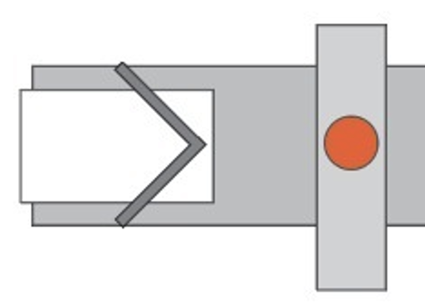
Agenda
Motor Parameters: motor's datasheet for:
Torque constant kt
Back EMF constant ke​
Resistance R
Inductance L
Inertia Jm
19.3 cm

Slide 4
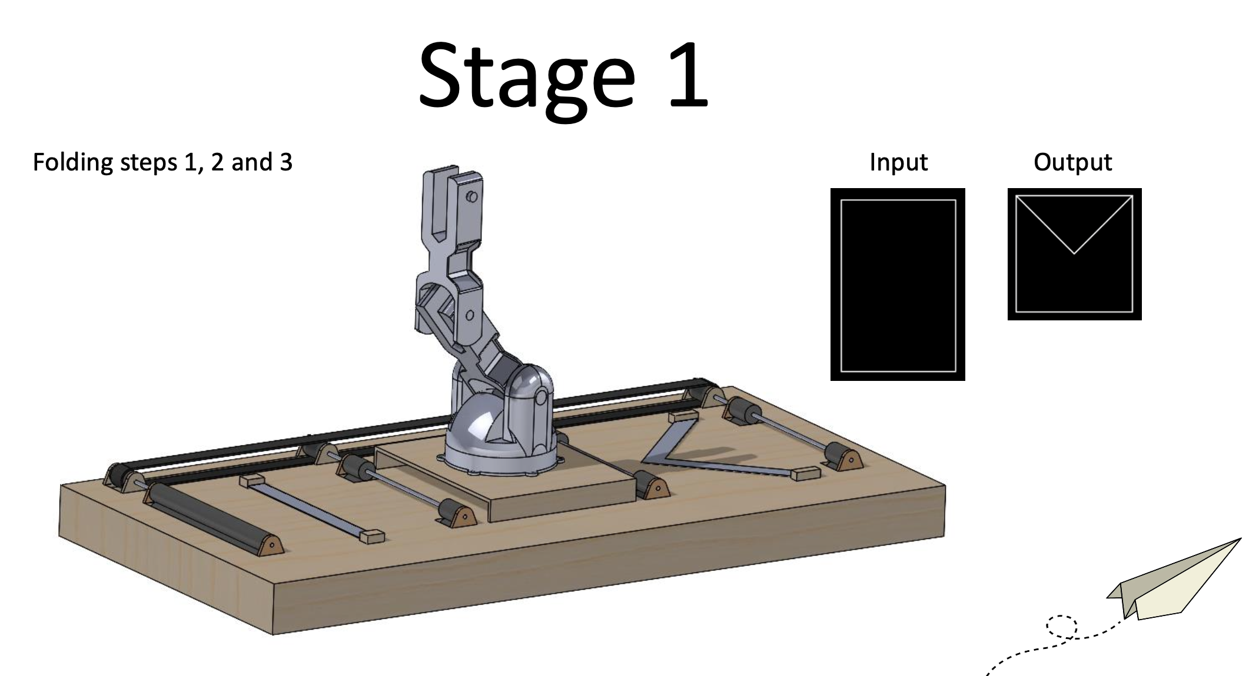
Parameters needed from UT: Folding Step 1
Physical Parameter Verification
Verify that the parameters used in the simulation accurately represent the physical system:
Motor Parameters: Measure or refer to the motor's datasheet for:
Torque constant kt
Back EMF constant ke​
Resistance R
Inductance L
Inertia Jm

Slide 5
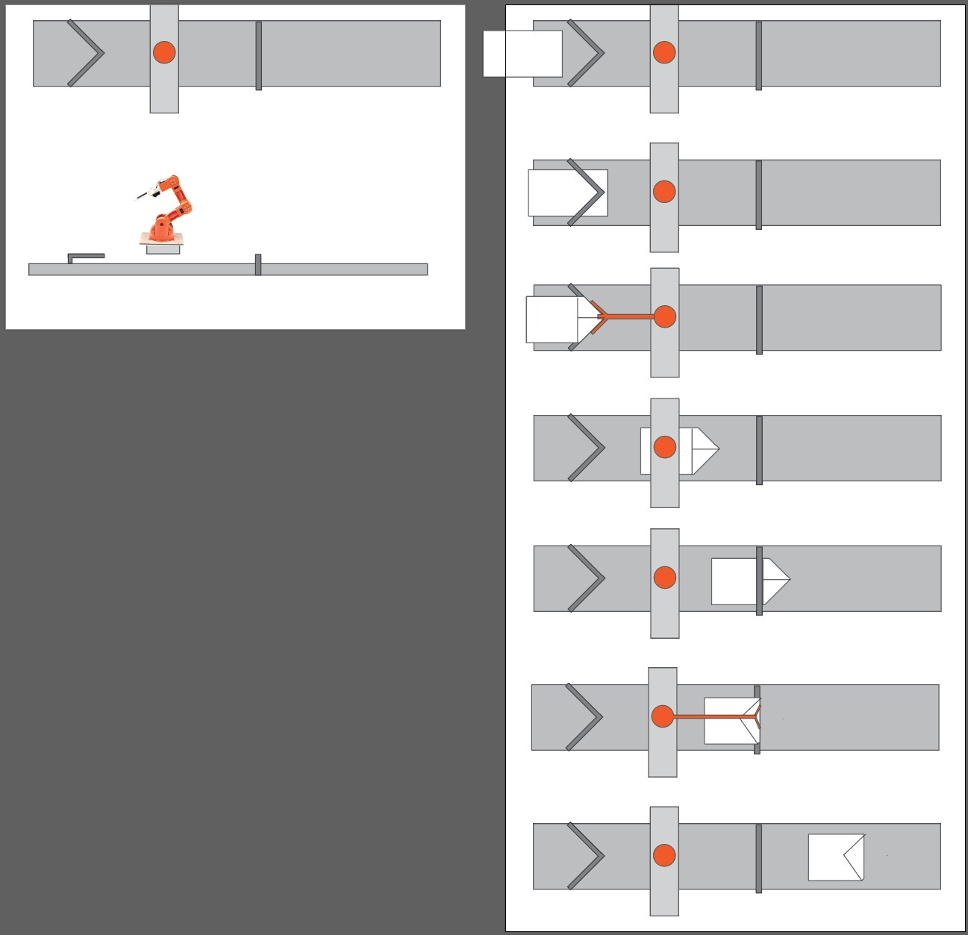
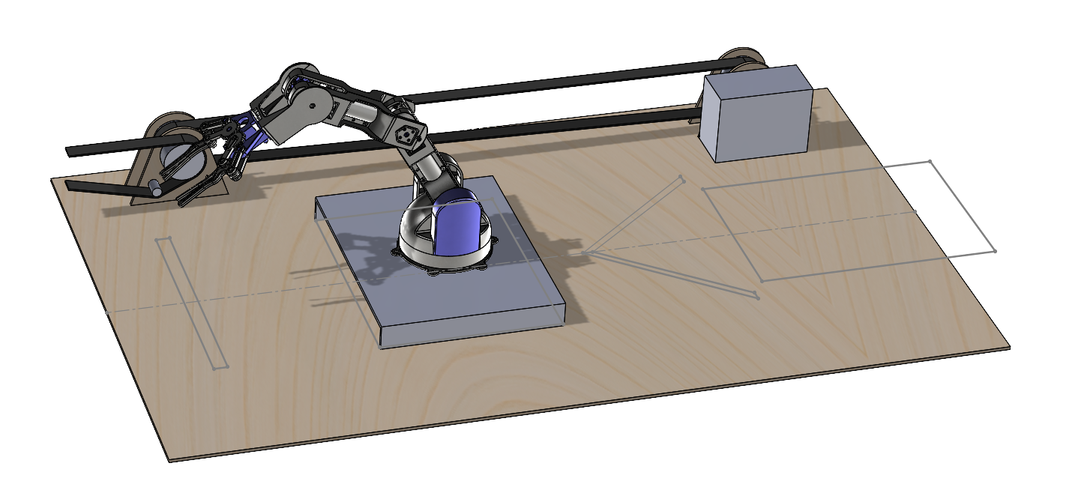
Parameters needed from UT: Folding Step 1
Gear Ratio: Ensure the 2:1 gear ratio is accurate.
Belt Radius r: Measure the actual pulley radius.
Paper Mass mp​: Measure the mass of the A4 paper (standard: ~0.05 kg).
Friction Coefficient μ: Use empirical testing (e.g., sliding paper on the belt) to measure μ.

Slide 6
Parameters needed from UT: Folding Step 1
Physical Parameter Verification
Verify that the parameters used in the simulation accurately represent the physical system:
Motor Parameters: Measure or refer to the motor's datasheet for:
Torque constant kt
Back EMF constant ke​
Resistance R
Inductance L
Inertia Jm

Slide 7
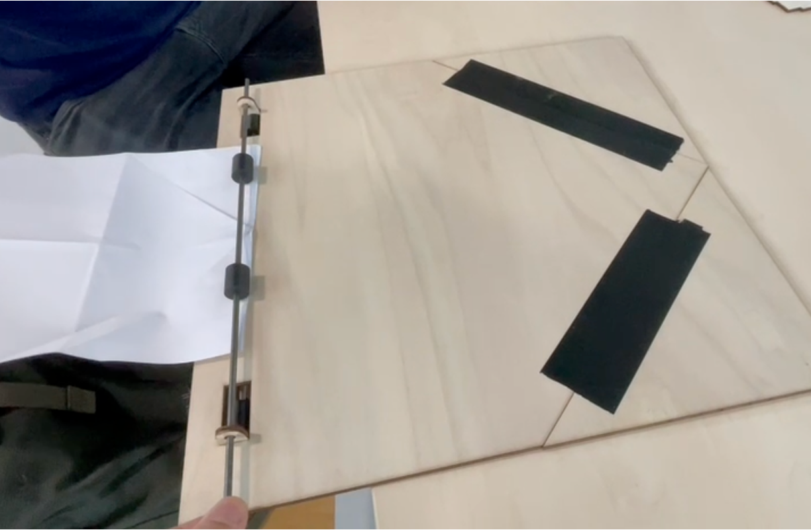
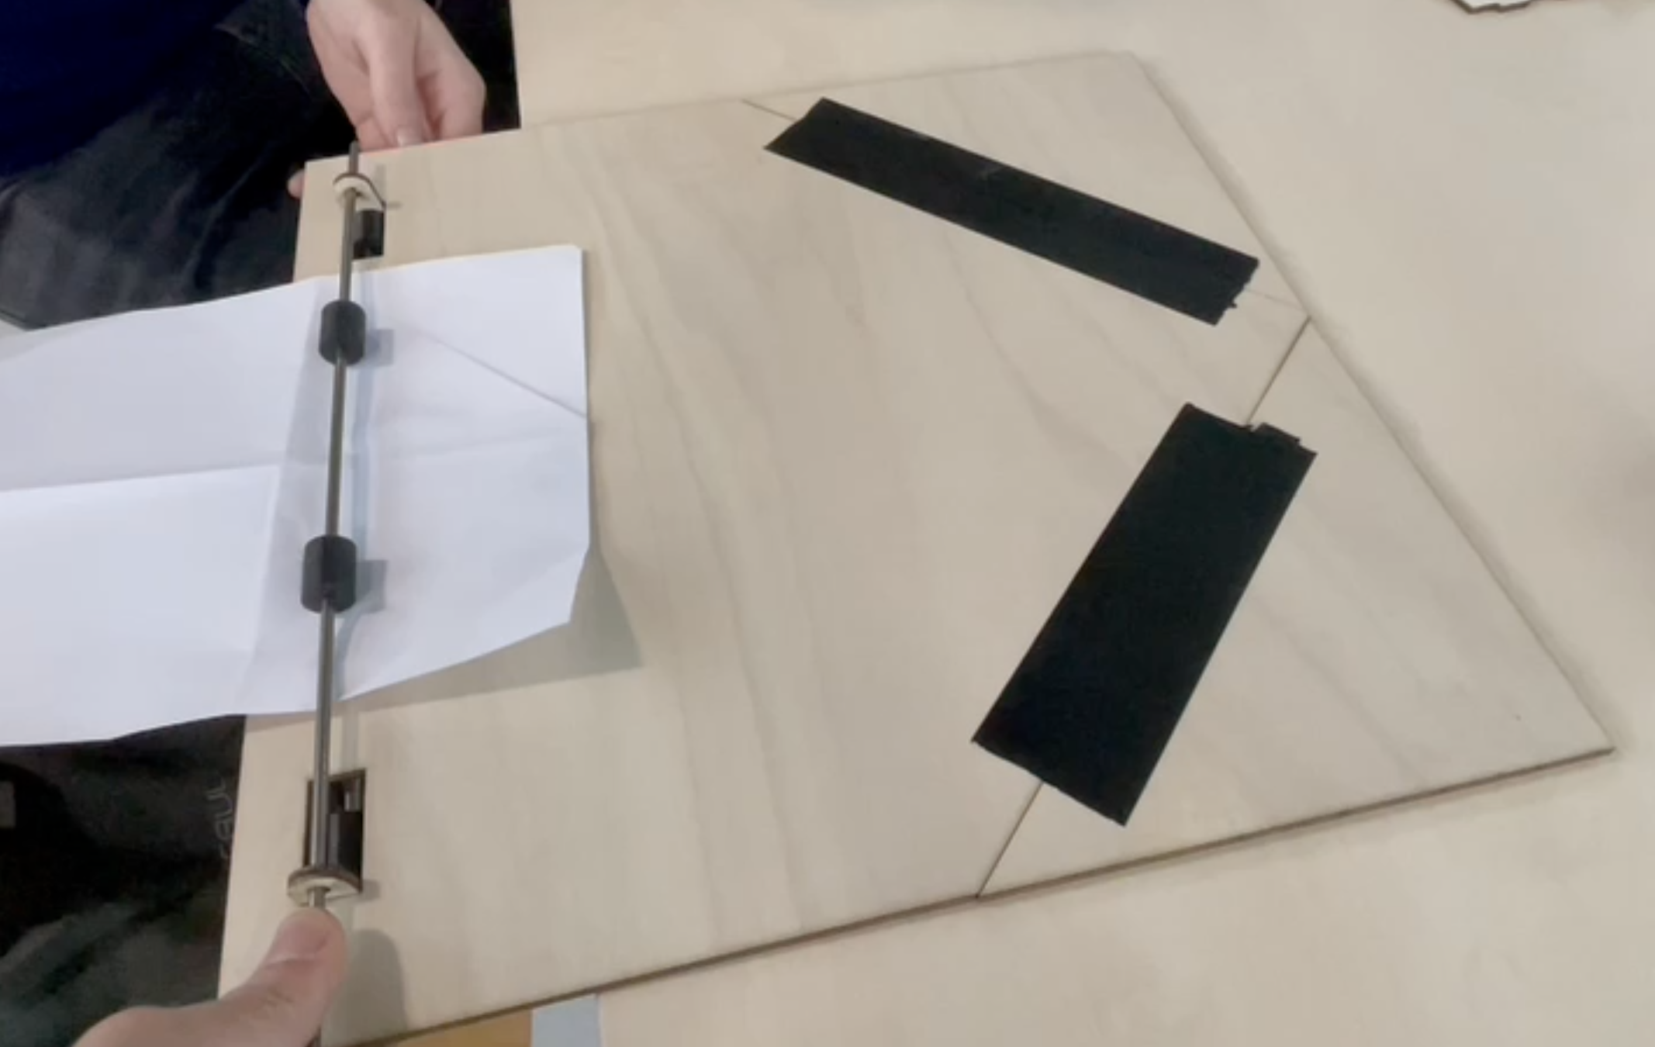
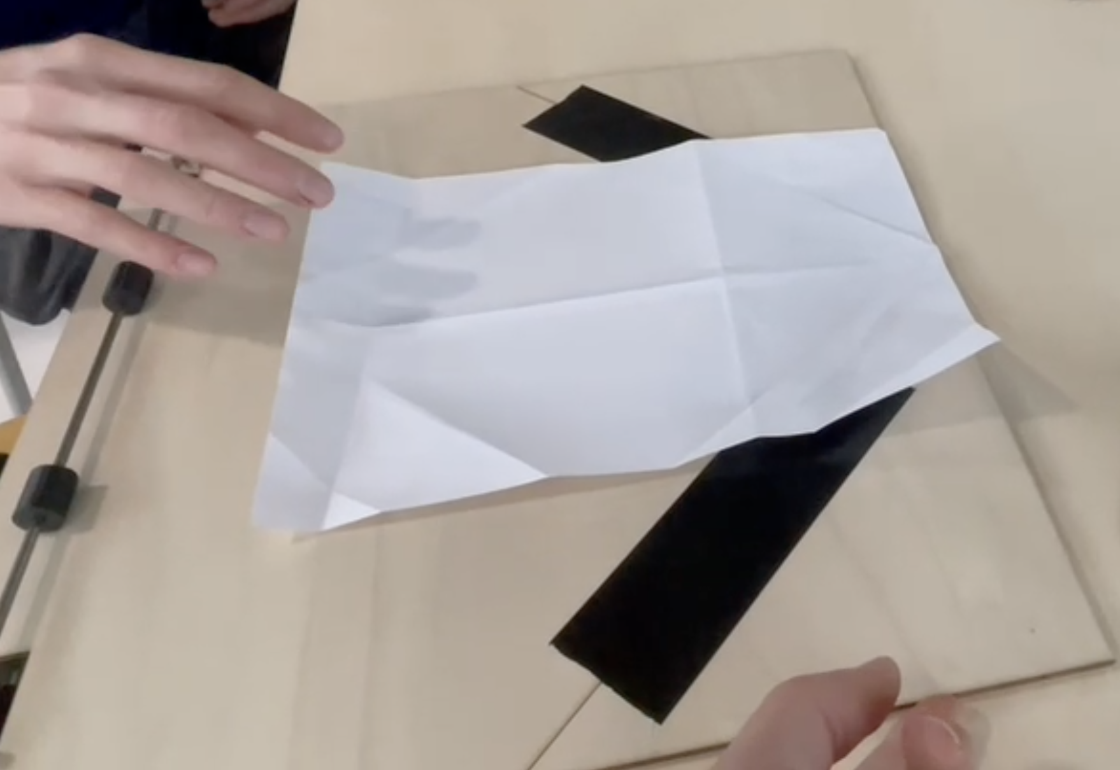
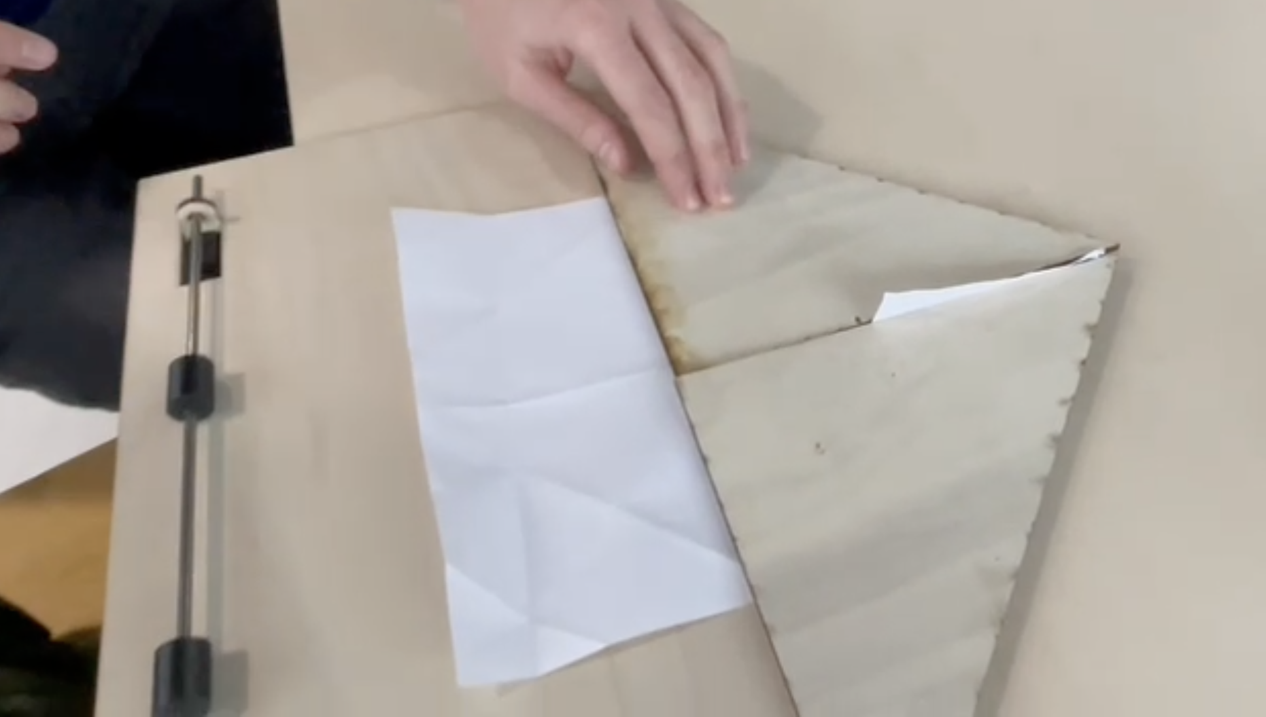
Rolling Gap | Friction Coefficient

Slide 9
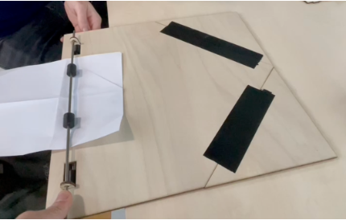
Friction Coefficient between paper and floor : µ_{PF}
Friction Coefficient between roller and paper : µ_{RP}

Slide 10
_
Thank you!

